Slide 1
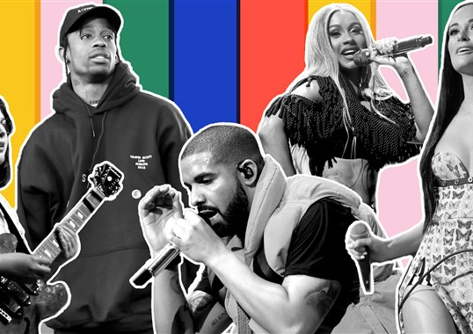
Wrecking
America’s
Old Town
Gian Millare
Eric Huey
Nelson Tsai

Slide 2
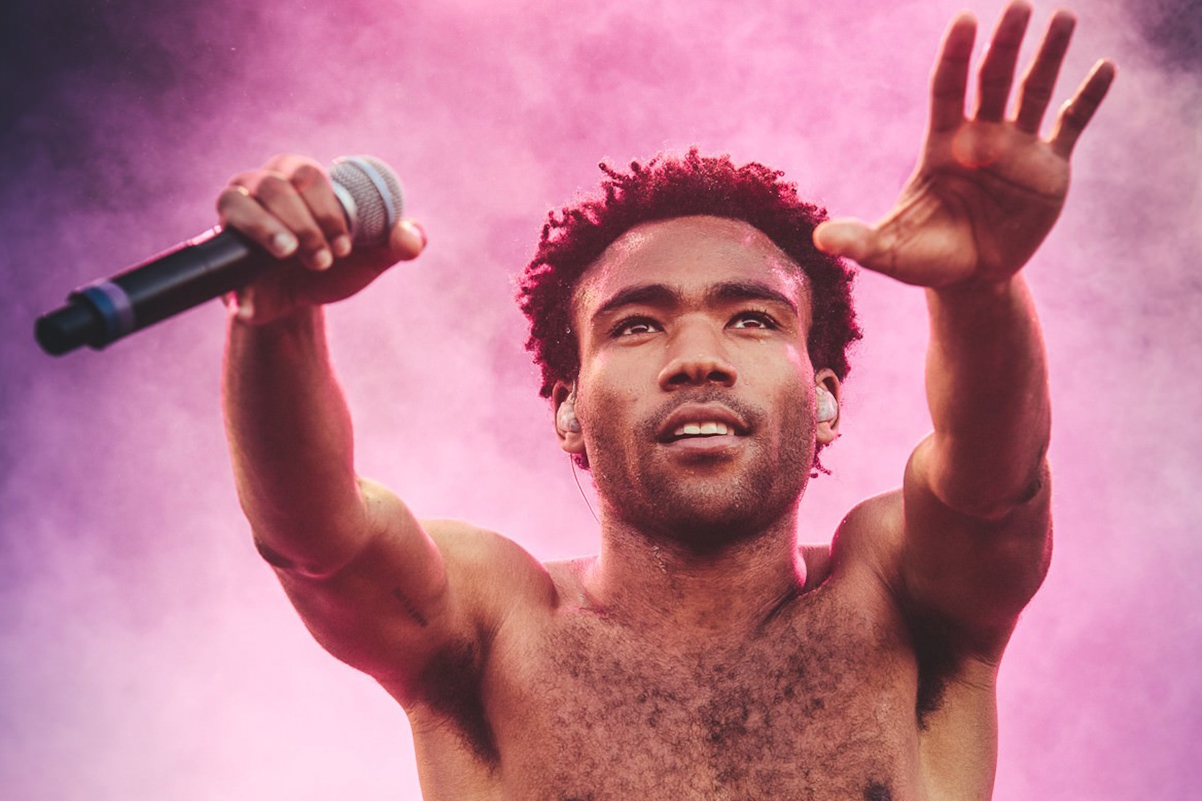
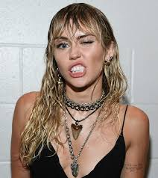
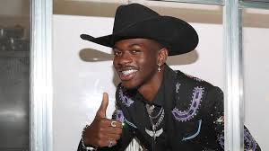
THE TEAM
Gian Millare
Analyzing:
“This is America”
By: Childish Gambino (Donald Glover)
Nelson Tsai
Analyzing:
“Wrecking Ball”
By: Miley Cyrus (Hannah Montana)
Eric Huey
Analyzing:
“Old Town Road”
By: Lil Nas X (Montero Lamar Hill)

Slide 3
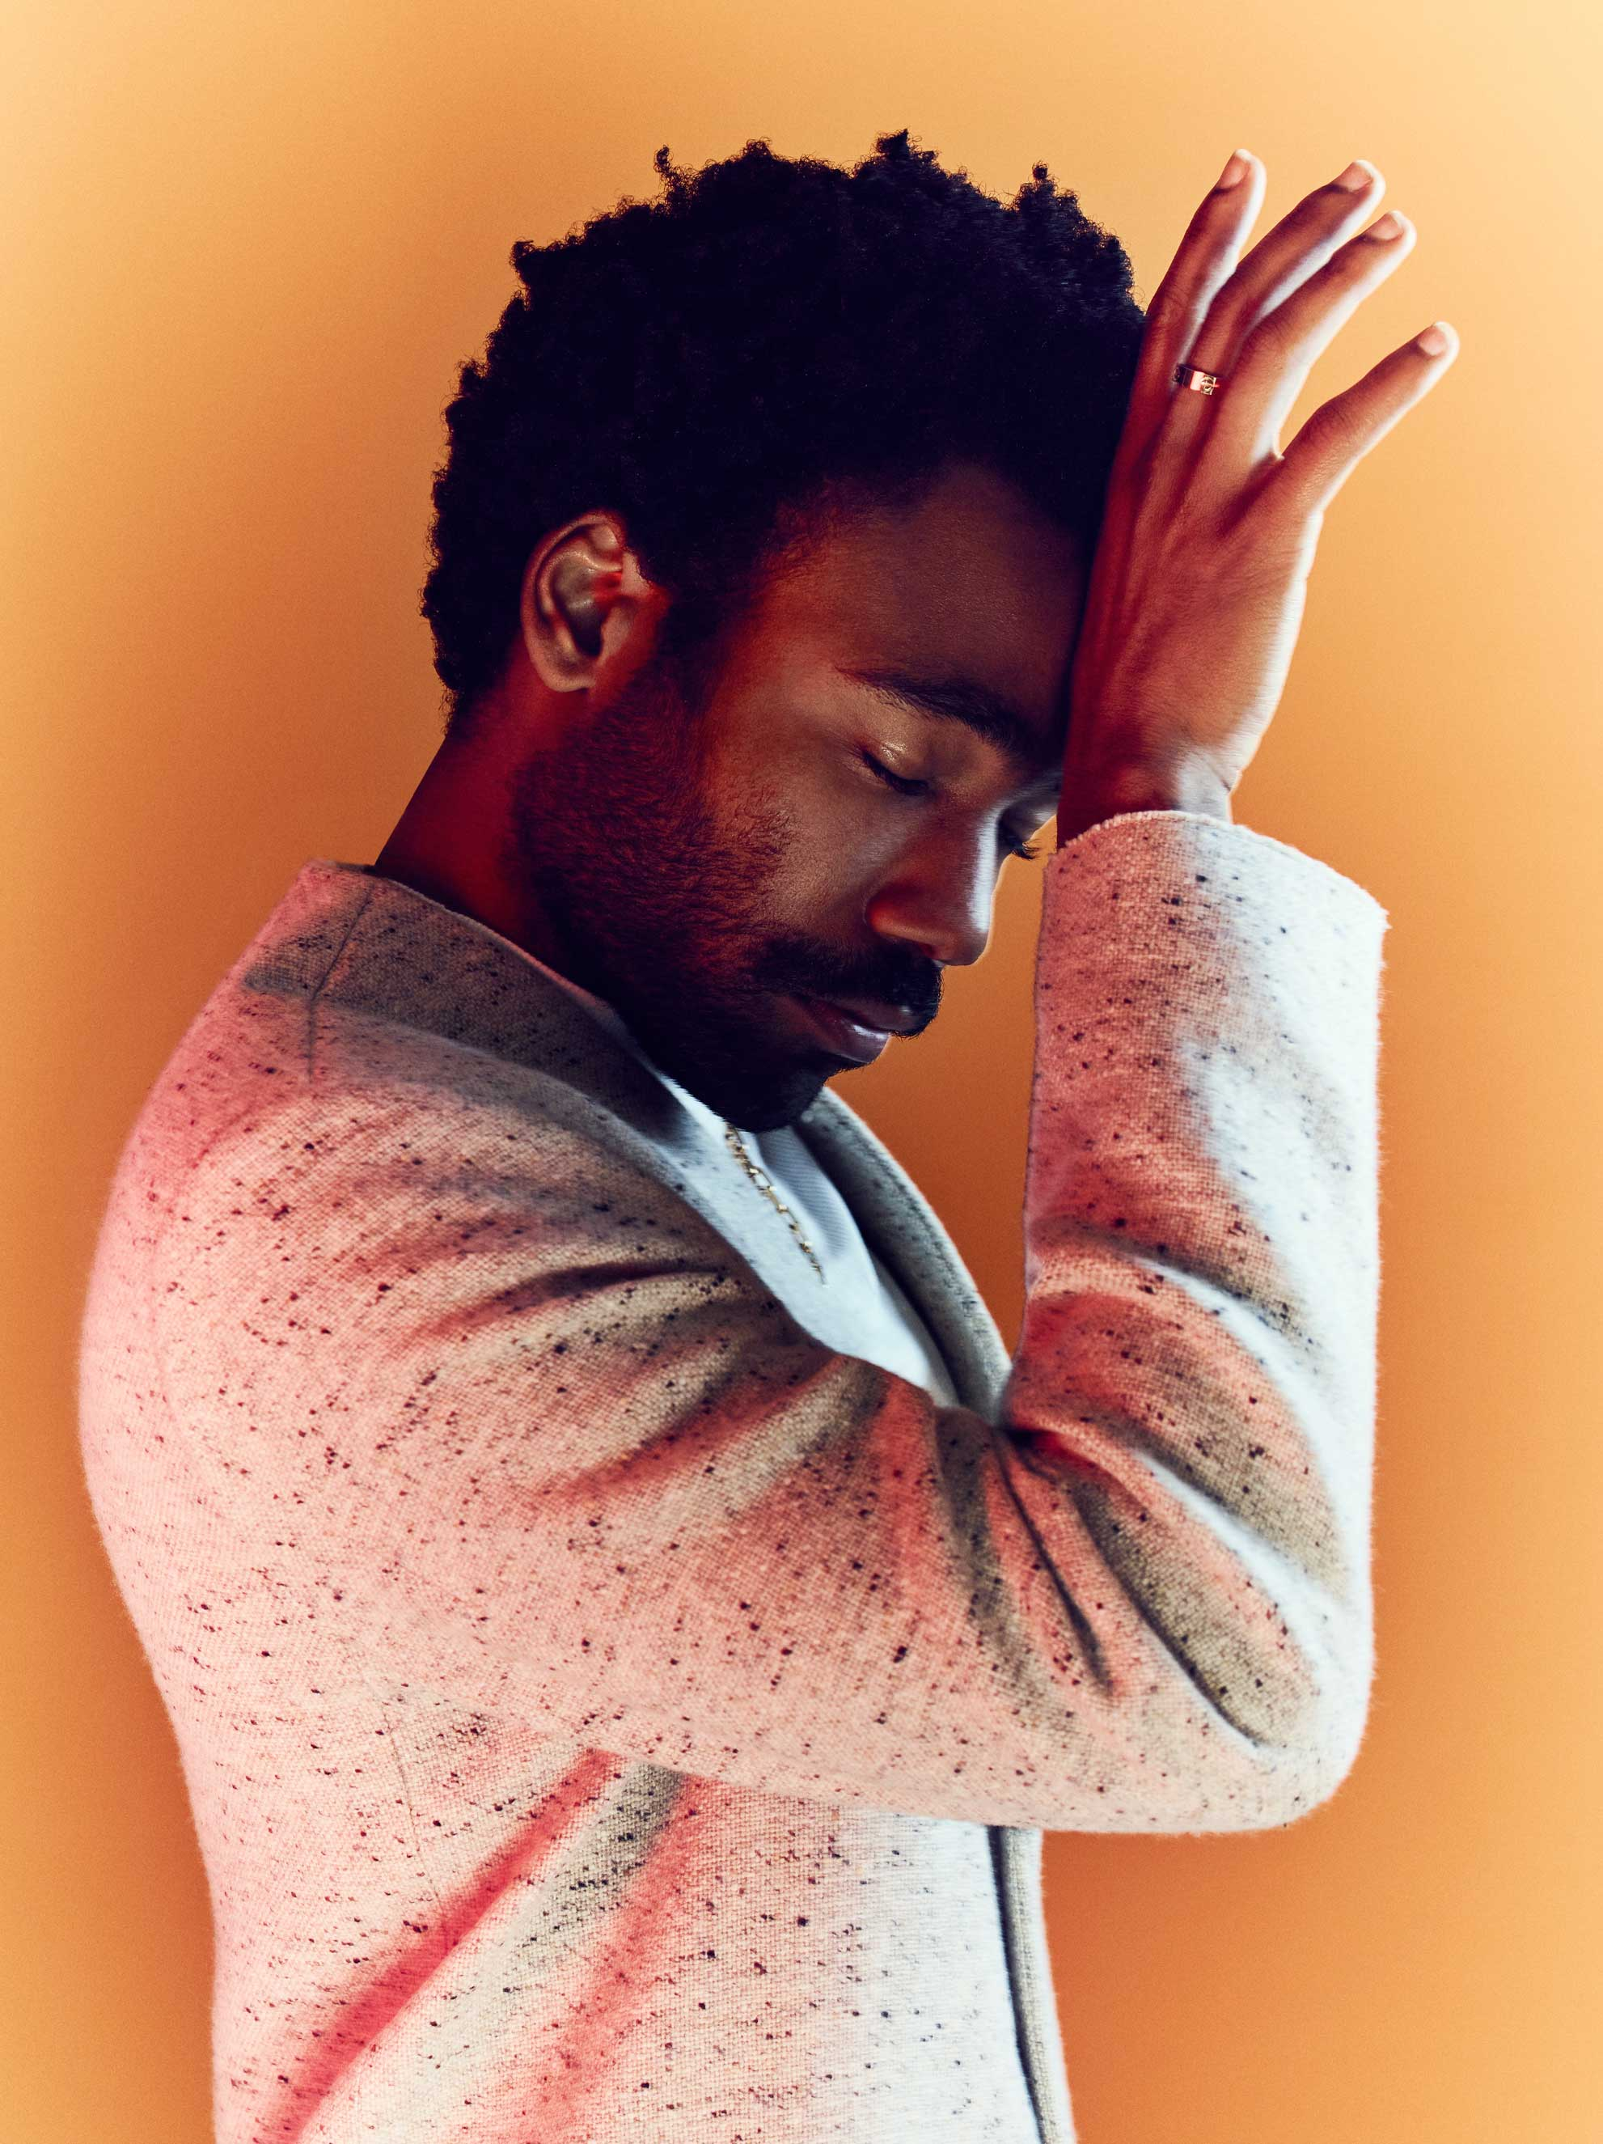
Motivation & Summary
Imagine you started your own record label. You have a great up and coming artist that you just signed to your label. Looking at what other artists did and the views they got with controversial music videos you think, is it worth it?
Our topic is on whether or not making a controversial music video would increase the audience size of an artist. We asked this questions because we were genuinely curious if this was a viable tactic to grow, based on current rage culture.
We were able to answer this question but not to the depth that we would have liked due to no access to the in depth data that we would have used. We did manage to use views and likes and dislikes as a metric to see success.

Slide 4
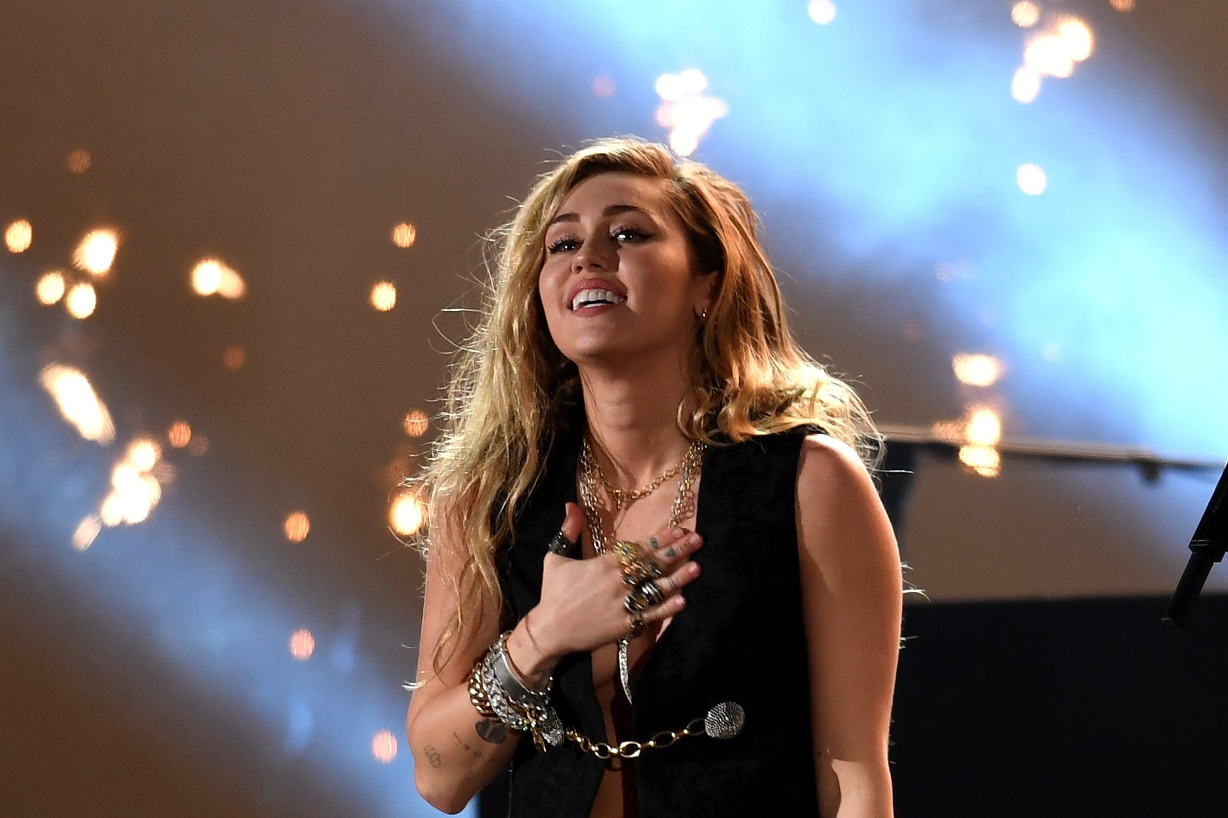
Questions & Data
Does creation of a controversial video equate to a larger audience?
We found the best way to do that was to use different artists as a showcase.
We had an ”Original” Plan that returned 99 problems and an answer wasn’t one. More details later.
Youtube Data V3 API
Youtube Videos CSV (from Kaggle)

Slide 5
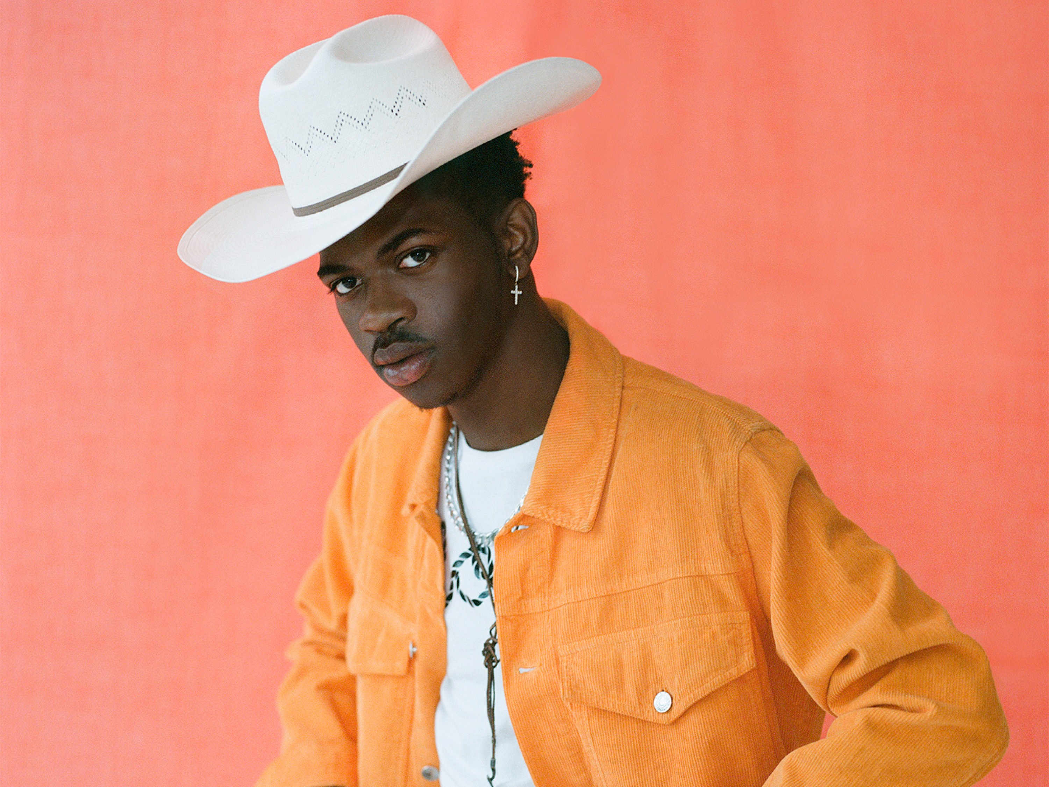
Data Cleanup & Exploration
Kaggle
Data.World
Youtube API
Social Blade
News API.org
Google News API
Most of the data we HOPED to get, failed us
There was a lot more interest in Social Media data
Laws prohibit because this is America
More information on Data Clean Up and Exploration in Analysis

Slide 6
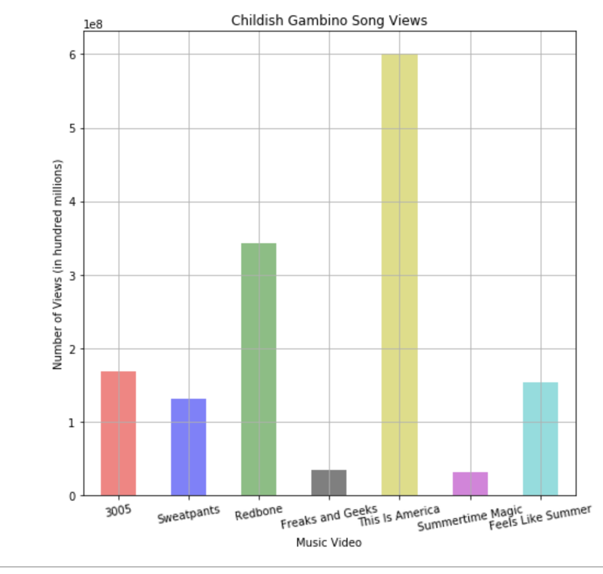
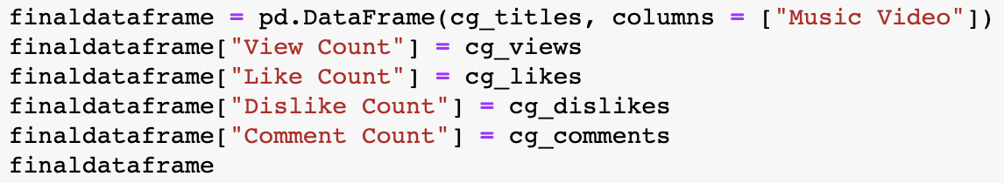
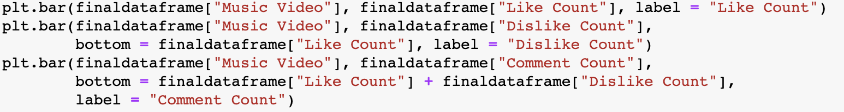
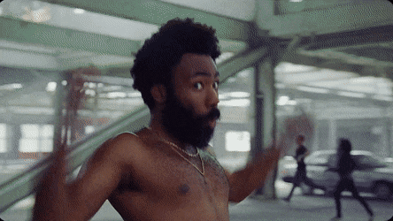
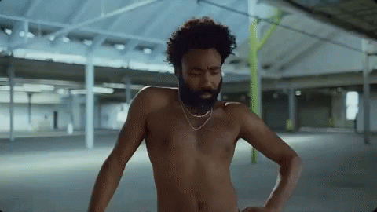
https://www.nbcnews.com/news/nbcblk/america-donald-glover-s-shocking-new-video-tackles-race-violence-n872126
A Childish Analysis by a Childish Analyst
By: Gian Millare
Step 1: Pull data from YouTube Data V3 API (developers.google)
Step 2: Create a For Loop to gather data from the responses, and
append the necessary metrics for the plots
Step 3: Create a final “master” data frame to create the plots
Step 4: Create the necessary plots (Bar Plot for simplicity)

Slide 7
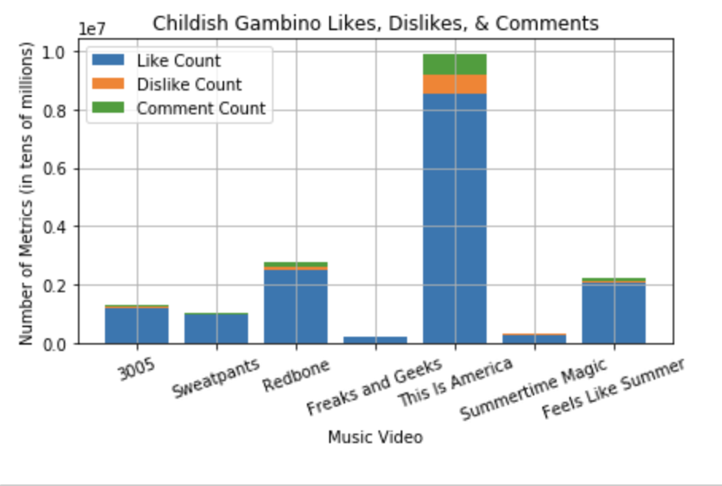
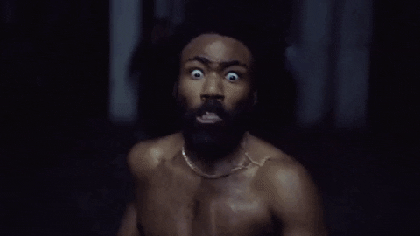
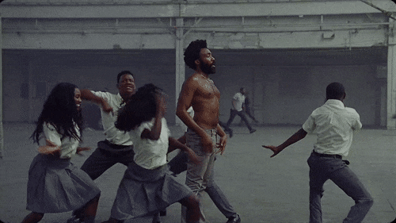
But Gian, What does this data tell us?
Controversial Video vs Non-Controversial (Views)
- Substantial Increase in Views
Controversial Video vs Non-Controversial (Metrics)
- Substantial Increase in audience interaction
Deeper thoughts?
“3005” released in 2013
“Redbone” released in 2016
FLS released late 2018
Pre-TIA views > Post-TIA views
Final Thoughts?
Bigger audience?
- YES
Keep audience?
- Doubtful
Food For Thought?
- People listen when they care
about what you say

Slide 8
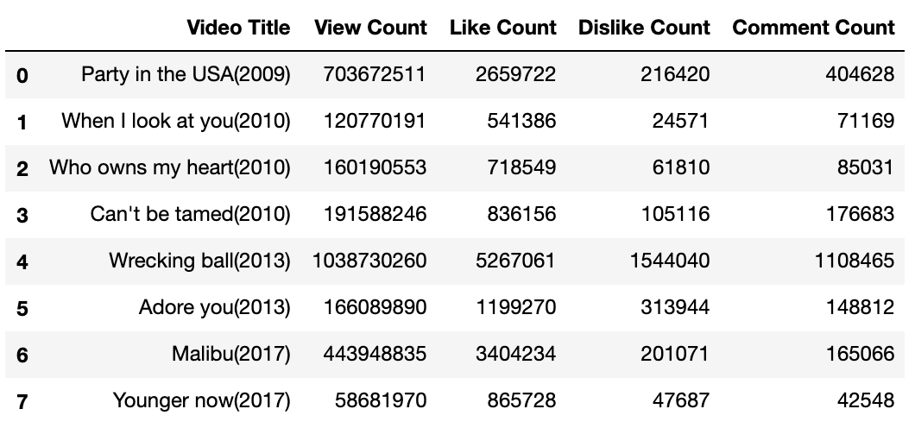
https://www.news.com.au/entertainment/music/music-videos/miley-cyrus-claims-the-wrecking-ball-video-is-her-biggest-regret/news-story/983ad0217a4cbd18d64bab19a00d8b66
Miley Cyrus Video Views
1. Pulled data from Youtube API from videos that Miley Cyrus made.
2. Cleaned data in to data frames
3. Created table of views for Music Videos
4. Data shows after the controversial video that she on average got more views
Innocent
Controversial

Slide 9
Miley Cyrus Video Likes/Dislikes/Comments
Used cleaned data to plot out likes and dislikes and comments
Showcasing engagement with the audience the controversial music video has more dislikes and comments in proportion to all other videos
Surprising to see that the dislikes were proportionally larger after the controversial video compared to before.

Slide 10
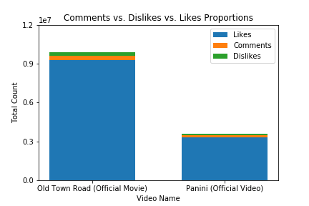
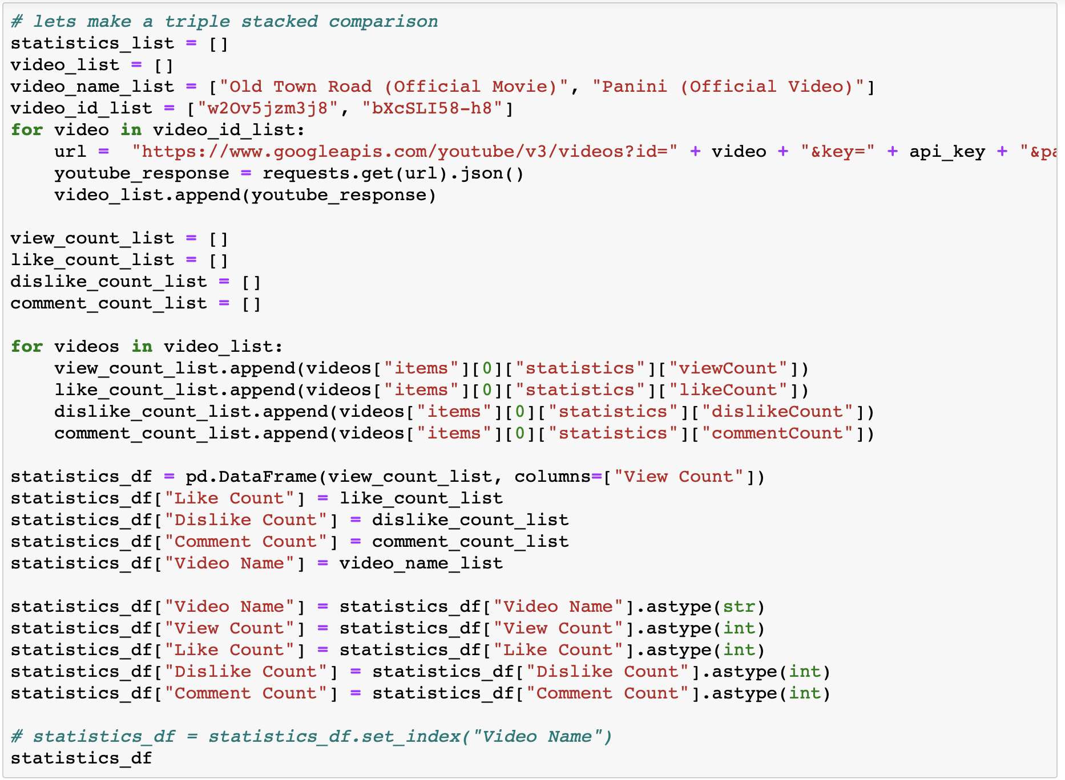

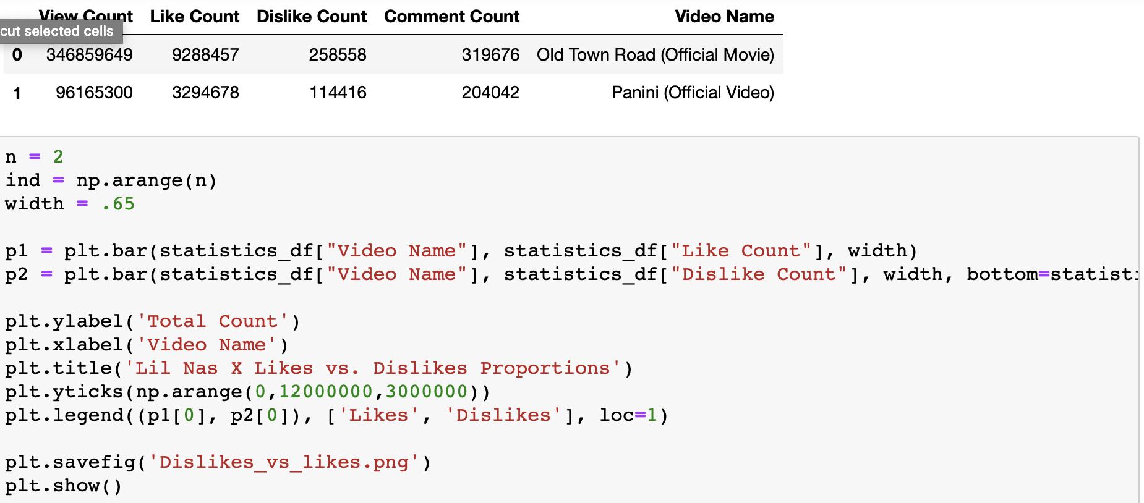
https://www.nytimes.com/2019/05/10/arts/music/old-town-road-lil-nas-x.html
Yeehaw? Yee NAW by Eric Huey
Lil Nas X’s video proved to be controversial by classification of genre rather than by the video’s content!
Let’s compare Lil Nas X’s viral yet controversial to his other “outlier” video, Panini: Despite Panini being the most popular video following Old Town Road, their breakdown is similar in that neither are truly controversial videos. Due to multiple videos showing average viewership in between these two videos, we can’t say that either of these two videos strongly retained audiences.

Slide 11
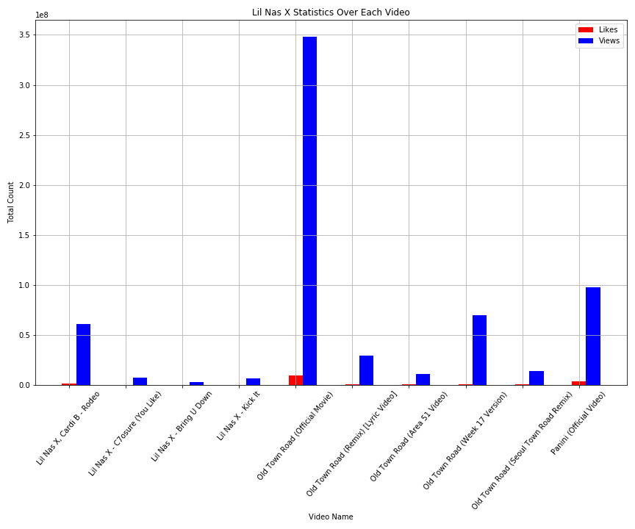
We notice here that the immediate video following Old Town Road barely does any better than the average video count.
Also how many versions of Old Town Road can you make? Apparently 5, but none of them ever beat or even came close to original.
Weirdly enough the lyric video has the highest percentage of dislikes per video.

Slide 12
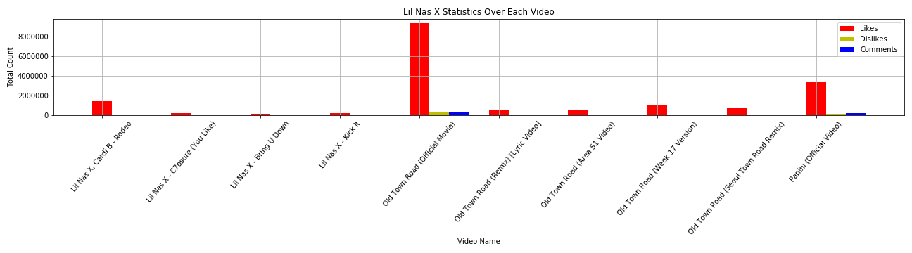
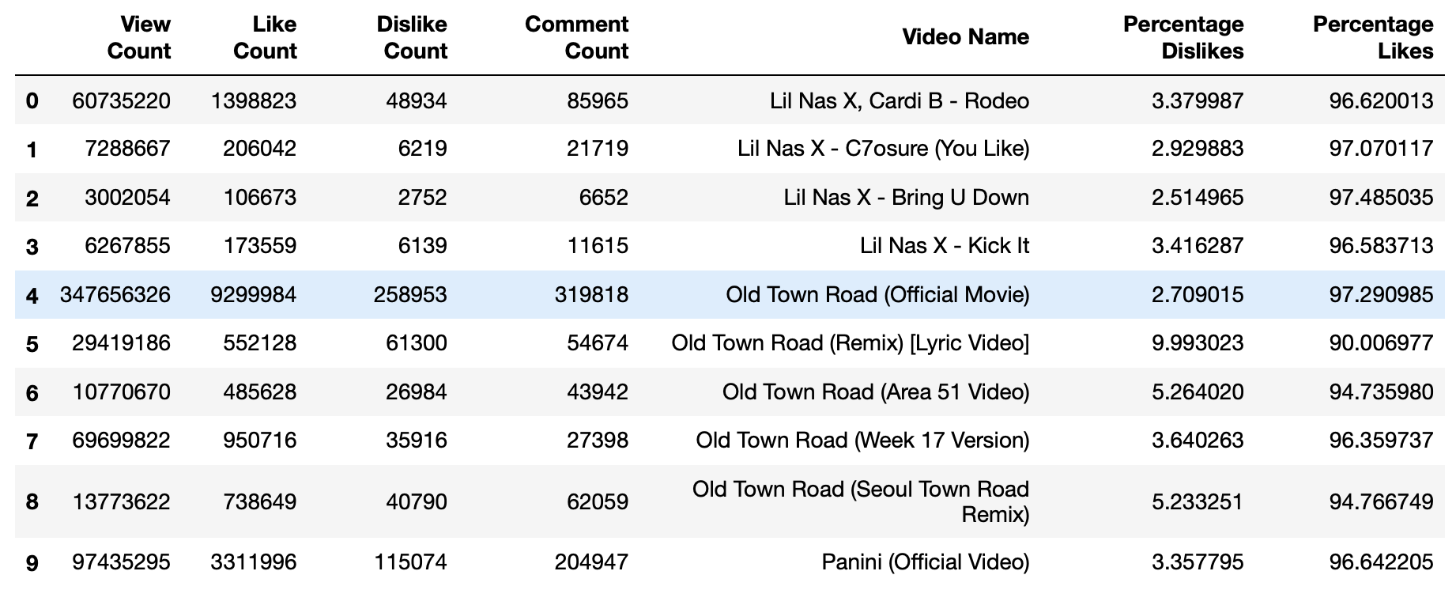
Flex with these next level bar charts though
Chronologically starting from Lil Nas X’s first video, we can see that his big break out video did very little to increase the viewer count of his next videos.
In general, it takes about the same amount of effort to “Dislike” as it does to ”Comment”!
Maybe we need to look at artist featuring? It seems like he’s attempting to milk Old Town Road for a while.

Slide 13
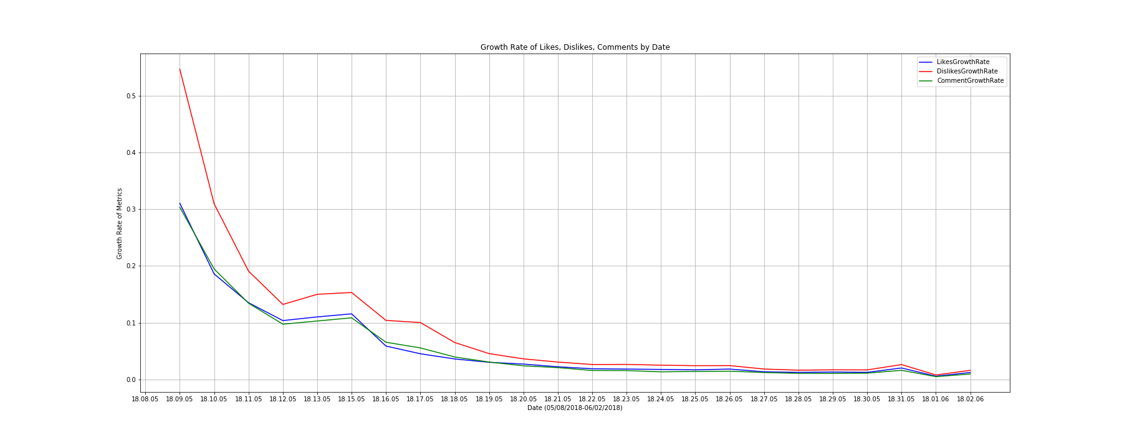
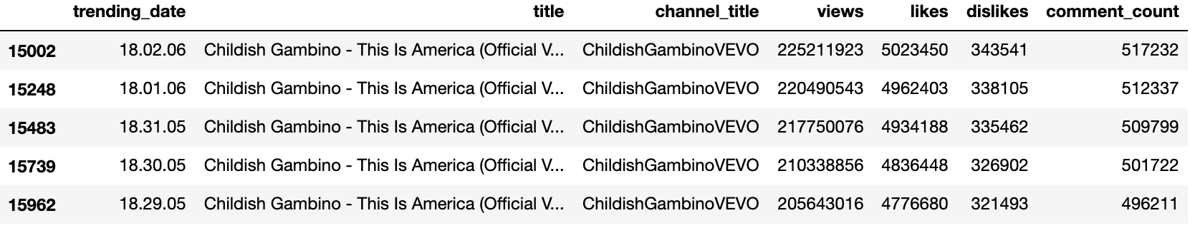
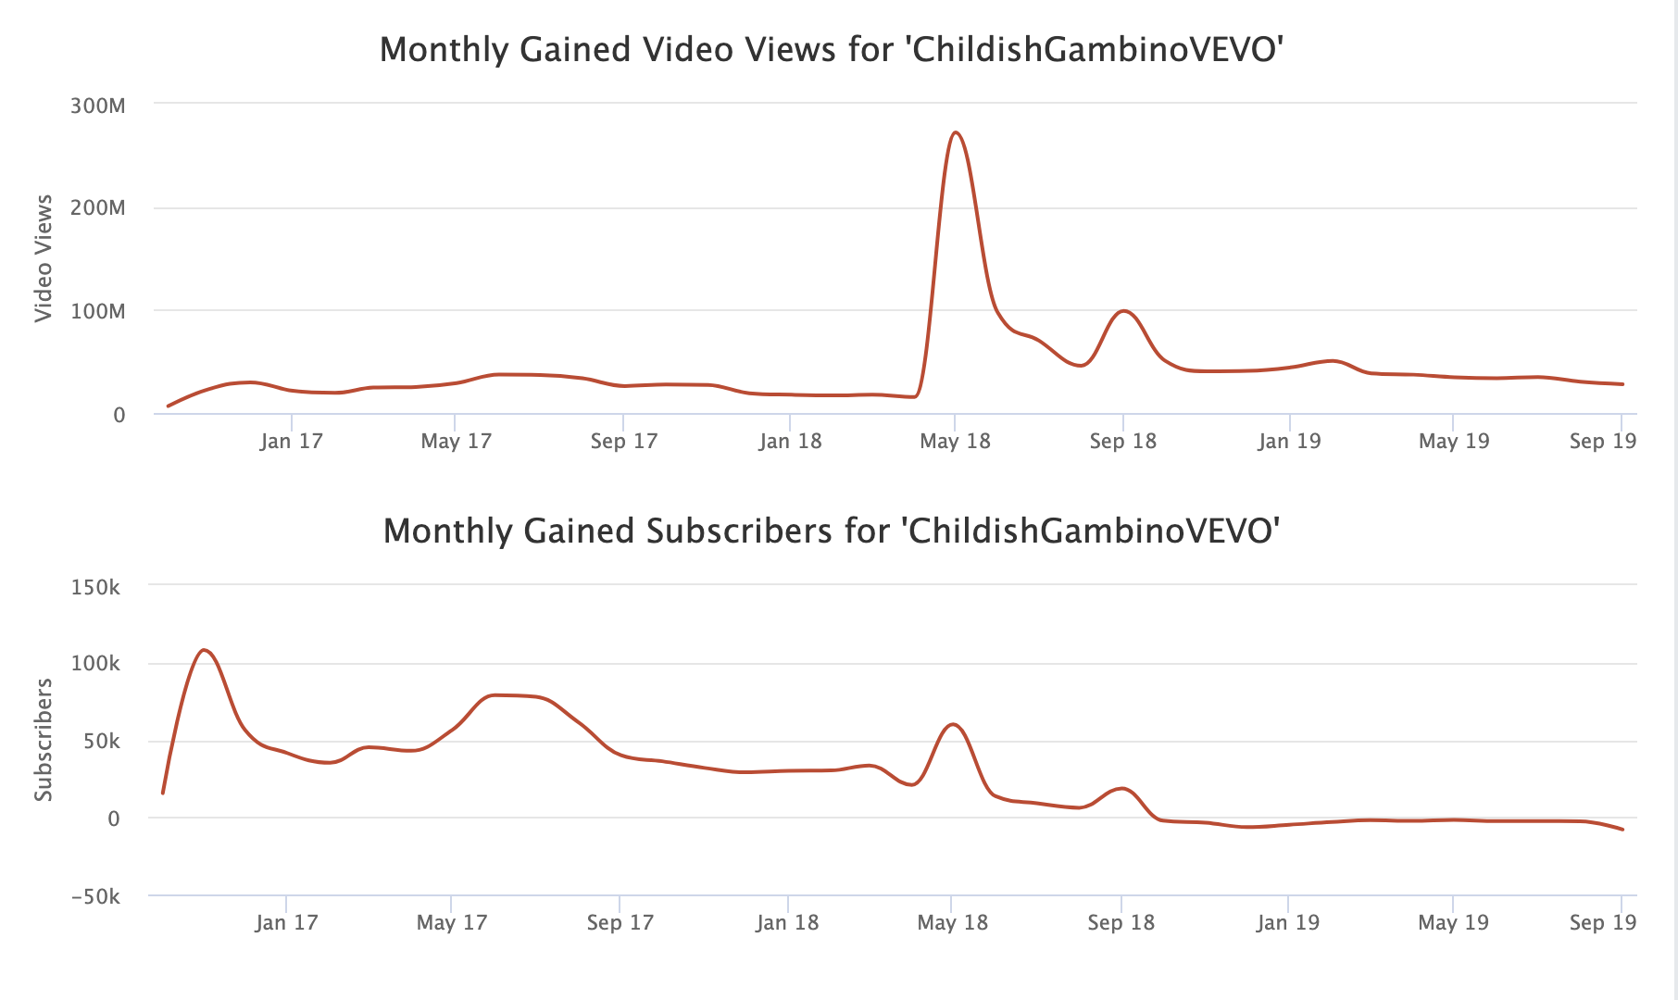
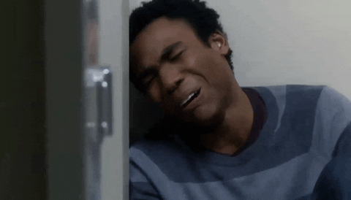
“Original” Data Analysis Plan:
Step 1: Collect metrics from Datasets (CSV), like Kaggle
Step 2: Create data frame, order by date, collect growth
Step 3: scatterplots to show growth rate through time
Step 4: Repeat for other songs by same artist, compare
Why was this plan tossed?
https://socialblade.com/youtube/user/childishgambinovevo

Slide 14
Discussion
Ultimately, whether or not a controversial music video boosted an artist’s average audience numbers still has too many factors to answer directly. But we can say that controversial videos often show singular spikes in an artist’s career, and that these spikes are relatively non-influential on following videos.
We also notice that most videos are dominated by Likes, and that Dislikes and Comments often share similar numbers. People may feel as strongly about disliking something as they do commenting!

Slide 15
Post Mortem
Our biggest difficulty was definitely getting the right data to work with. We either had to figure out multiple APIs to answer this question, or compromise with one and attempt to pull as much info as possible.
Overall, lots of questions arose but we didn’t have time to answer them all: Why doesn’t Youtube catalogue periodic data for all channels? What about statistical testing for the growth rates of view counts? Do videos consistently get more views than audio only? How much does an artist’s name on a track increase viewership? Retention? Who killed Tupac? The list goes on.

Slide 16
Questions ??

